Slide 1

PYTHON PROJECT
Fitness calculator
Submitted by:
Jaspreet Singh Kathuria
11918806
Puneet Kumar
11908274
Rashmi Kumari
11908242
Under the Guidance of
(Mr. Dipen Saini, Assistant Professor)
School of Computer Science and Engineering
LOVELY PROFESSIONAL UNIVERSITY

Slide 2
INTRODUCTON
Project choose by our team is Fitness Calculator. It is for a Single User. It will generate report of single person at a time.
This Mini project of “Fitness Calculator” is purely made in python, with a good user-friendly interface which lets the user to enter the various values required to be input in order to calculate how fit the person is.
This project uses tkinter library which is used to make the G.U.I. Some modules of tkinter used are buttons, entry box, labels and progress bars.
All here are used to represent the report graphically to the user.
The main window consists of all the entry fields that the user is required to fill in order to generate a report. This main window also has a button to generate report when all the entry box has the required values.

Slide 3
PROBLEM STATEMENT
This Program generates report of the particular person with following labels:
• BMI
• Blood Pressure
• Pulse Rate
• RBC, WBC, Platelets Count
• Haemoglobin level
• Uric Acid level
• Cholesterol level
and categorize it as high, low and normal.
These different values are colored according to how harmful they are on the individual’s health. This makes it easier for the user to view the report, moreover “tk” module of tkinter library is used to show these values as a progress making it easier for the person using the app.

Slide 4
PROBLEM ANALYSIS
Program used a bunch of if statements used to decide the output according to the input given by user. This is the basic logic on which the program works.
The calculation of BMI and other values is done by using formulas and data collected from various websites is used to calculate the strength of a particular value in terms of High low or normal.
There are various functions and if statement which also control what color to change for the label when a certain value is entered.

Slide 5
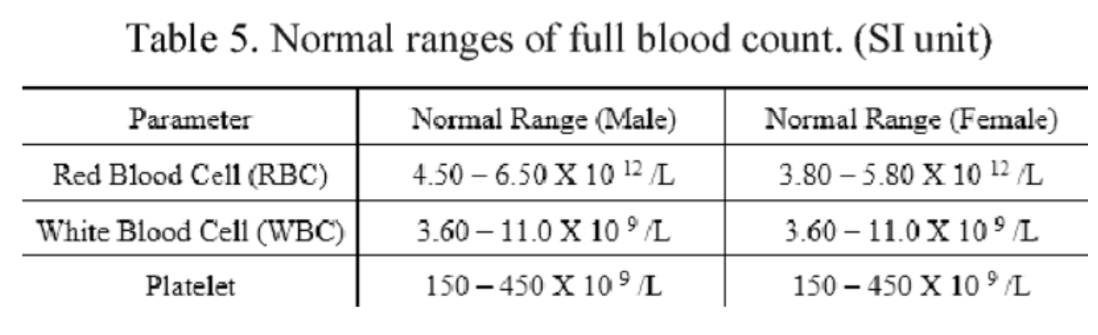
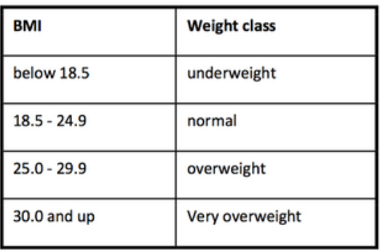
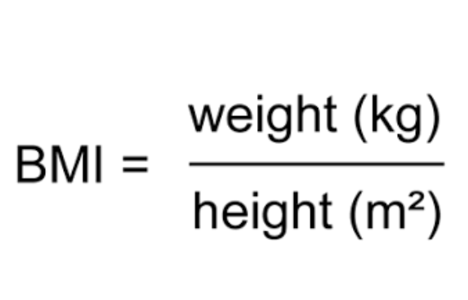

Slide 6
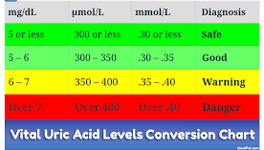
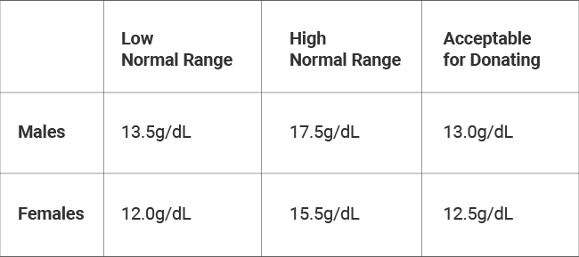
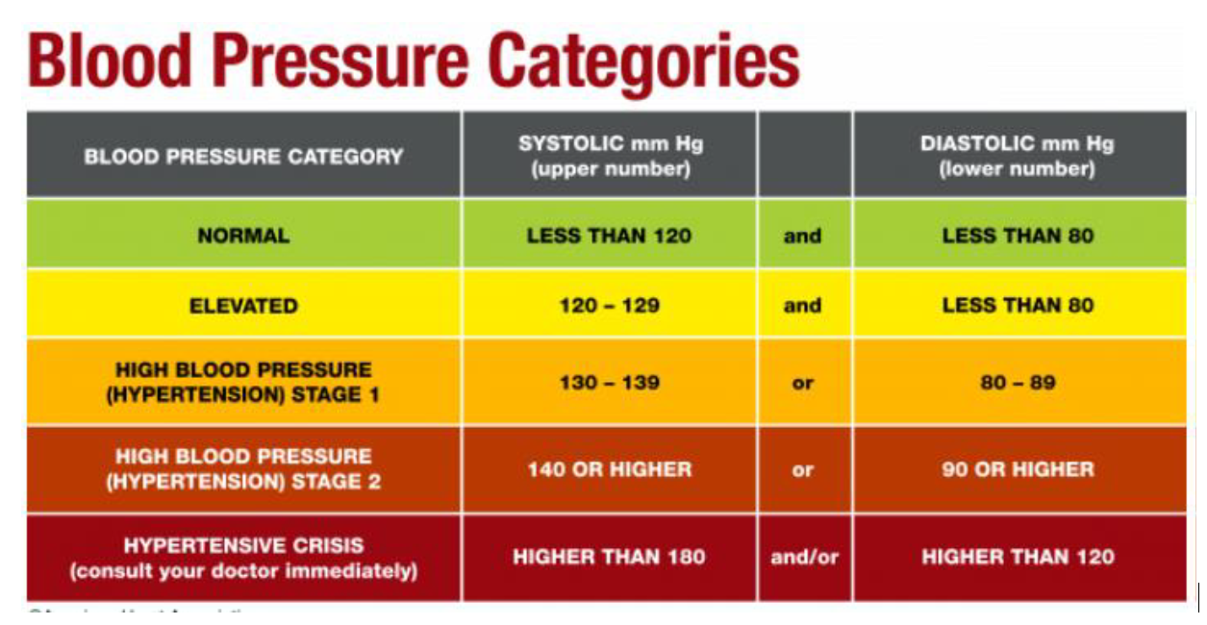
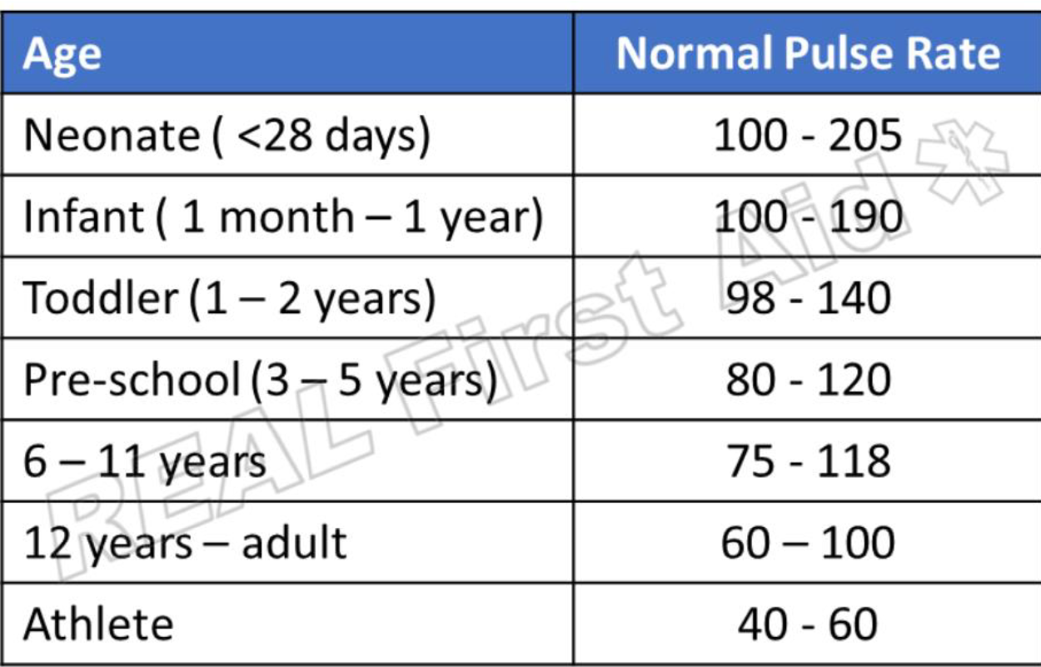

Slide 7
FUTURE SCOPE AND LIMITATION
Creating worldwide health platform to store and generate report of a person’s health. If someone’s health goes bad on this platforms, different health organizations aka Hospitals can tap that person and help him to get to know the symptoms.
As the Future, the young generation of the world we have to take care of our health. Knowing the disease faster makes us having more chances of curing it more efficiently.
Though the system has been designed according to the requirements of the users it has its own limitation. Thus, the Limitation of system is: -
1.) No facility to generate report for multiple users.
2.) Data Used for Calculation is collected from various website. So, possibility of incorrectness of values.
3.) Data is not stored in the memory or in the file.

Slide 8
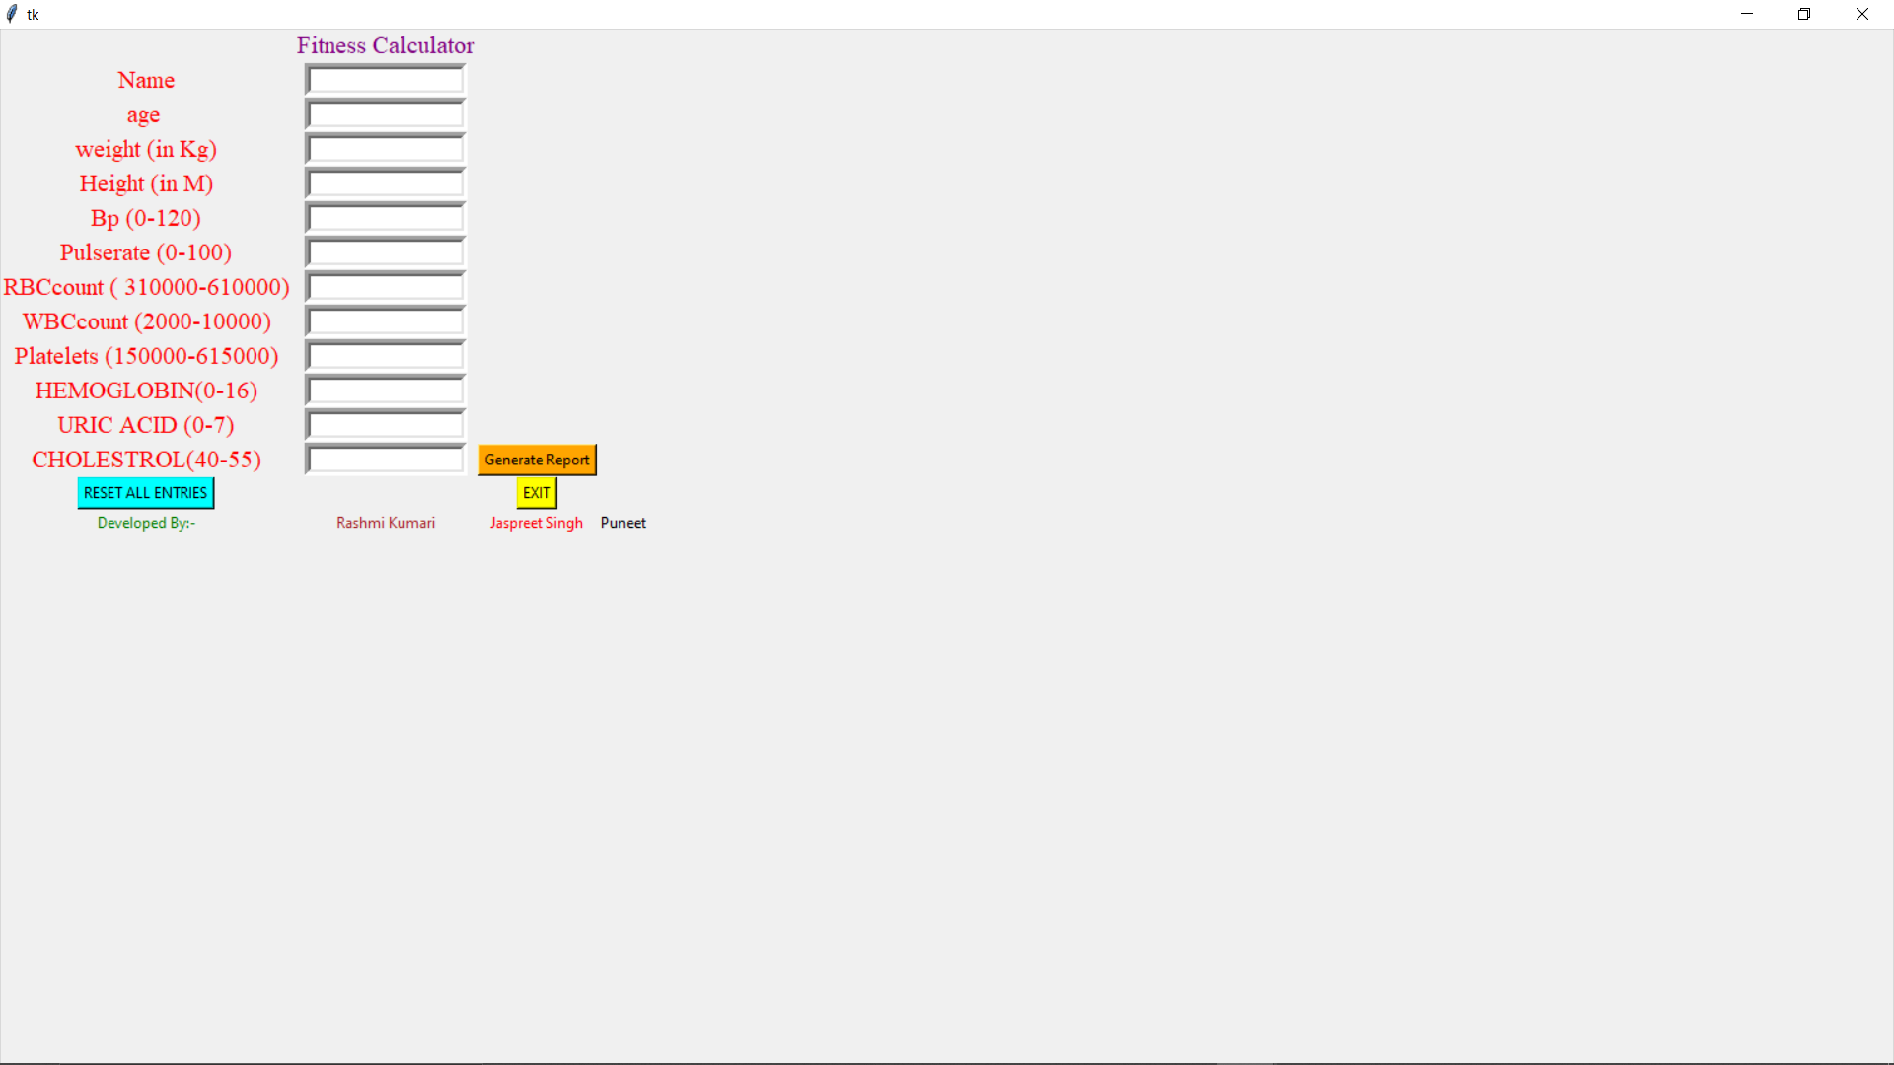
INPUT SCREEN

Slide 9
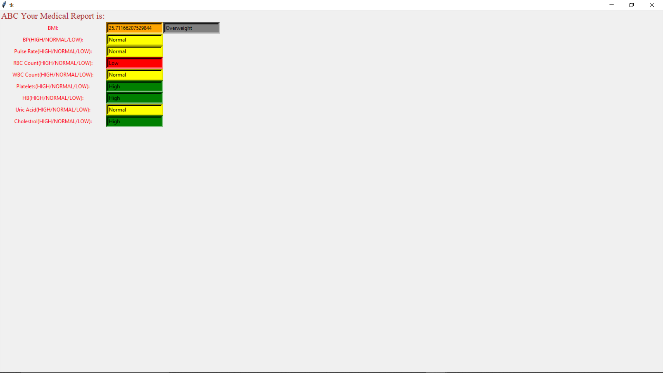
OUTPUT SCREEN

Slide 10


